Slide 1
Simulating the 2020 Presidential Election
by The Scandal Simulators
Yarden Blausapp, Missy Gerlach, Ben Limpich, and Brooke Taylor
Notes:
Ben

Slide 2
Goals

Slide 3
Goals
Predict 2020 election based on various events
Investigate how events change political opinions
Use simulation methodology to create social simulation
Create our own simulation from scratch
Understand discrete event simulation more
Notes:
Missy

Slide 4
Methodology

Slide 5
I. Discrete Event Simulation

Slide 6
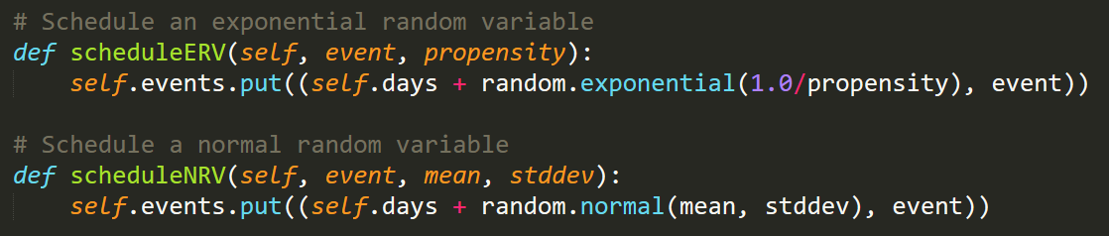
Simulation Structure
Discrete events
ERV and NRV
PriorityQueue
Notes:
Yarden

Slide 7
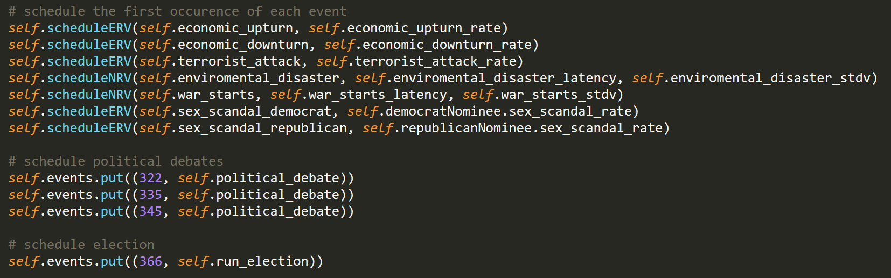
Simulation Structure
Event types:
ERV and NRV scheduled
Independent and dependent of candidate profile
Fixed schedule
Notes:
Yarden

Slide 8
II. Dividing the Voters

Slide 9
Brainstorming
Main decision: intersecting populations or discrete populations?
Divide by demographics
Individual voter objects
Notes:
Missy

Slide 10
What We Decided
Discrete population:
Voters that always vote Democrat
Voters that always vote Republican
Swing voters whose political opinions can be changed
Notes:
Brooke

Slide 11
Party Loyalty
Democrat
Republican
Swing
Notes:
Brooke

Slide 12
Political Topics/Groups
terrorism
economy
foreign policy
environment
immigration
candidate profile
other

Slide 13
Initial Voting Decisions

Slide 14
Final Voting Decisions (I)

Slide 15
Final Voting Decisions (II)

Slide 16
III. The Code

Slide 17
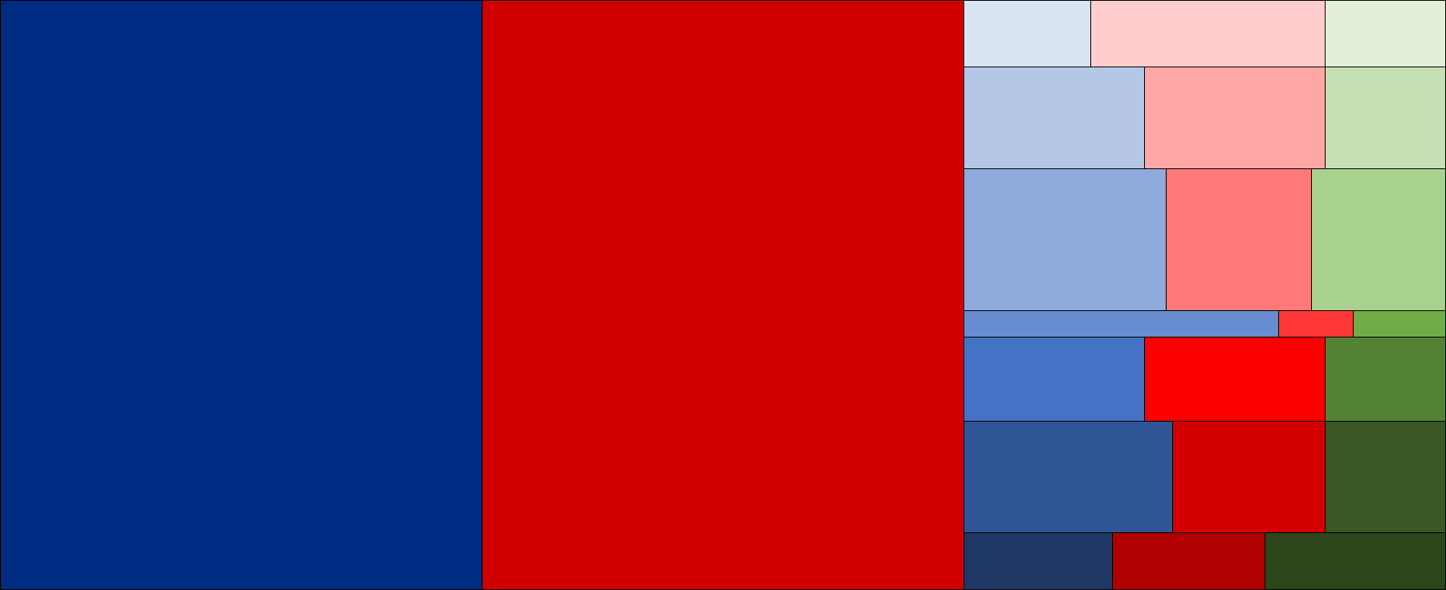
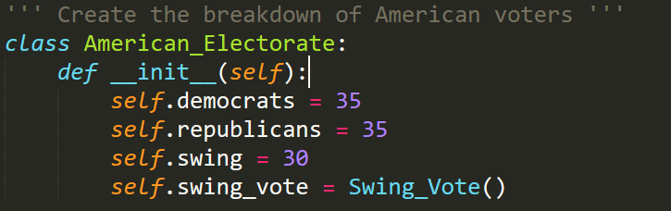
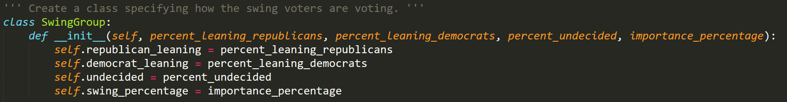
Voters
Notes:
Yarden

Slide 18
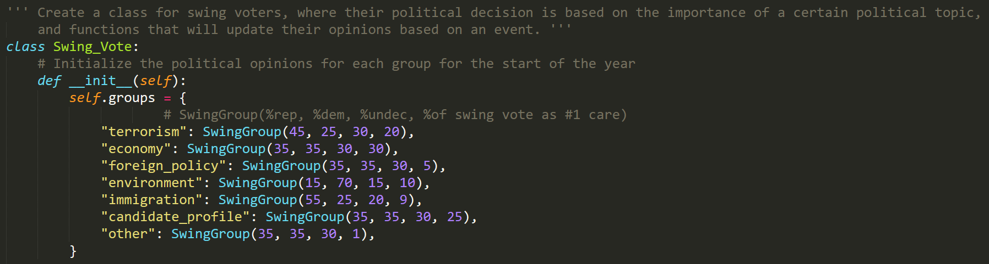
Swing Voters’ Important Topics
Notes:
Yarden

Slide 19
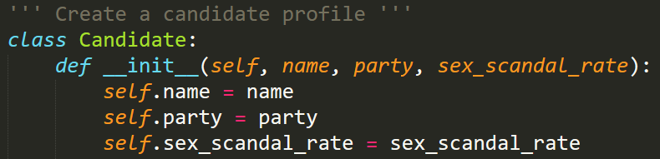
Candidate Objects
Notes:
Yarden

Slide 20
List of Events
Sex scandal (by Democrat or by Republican)
Economic upturn and economic downturn
Terrorist attack
Environmental disaster
War starts
Political debate
Notes:
Ben

Slide 21
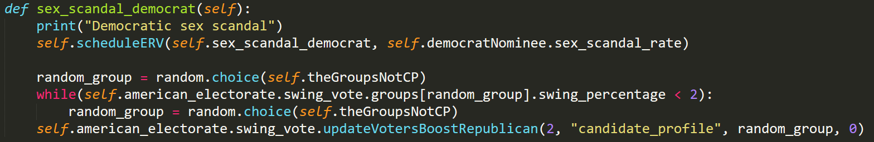
What an Event Does
Notes:
Ben

Slide 22
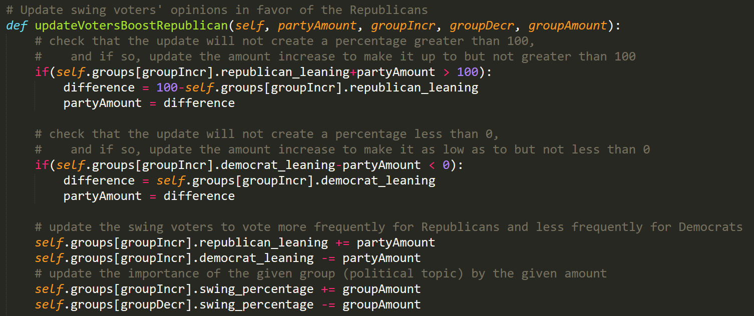
What an Event Does
Notes:
Ben

Slide 23
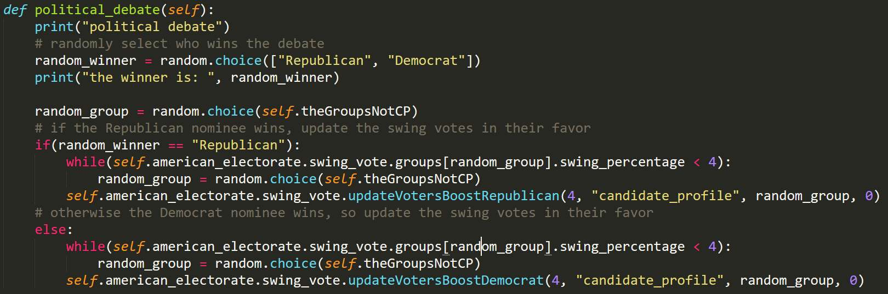
Political Debate
Notes:
Brooke

Slide 24
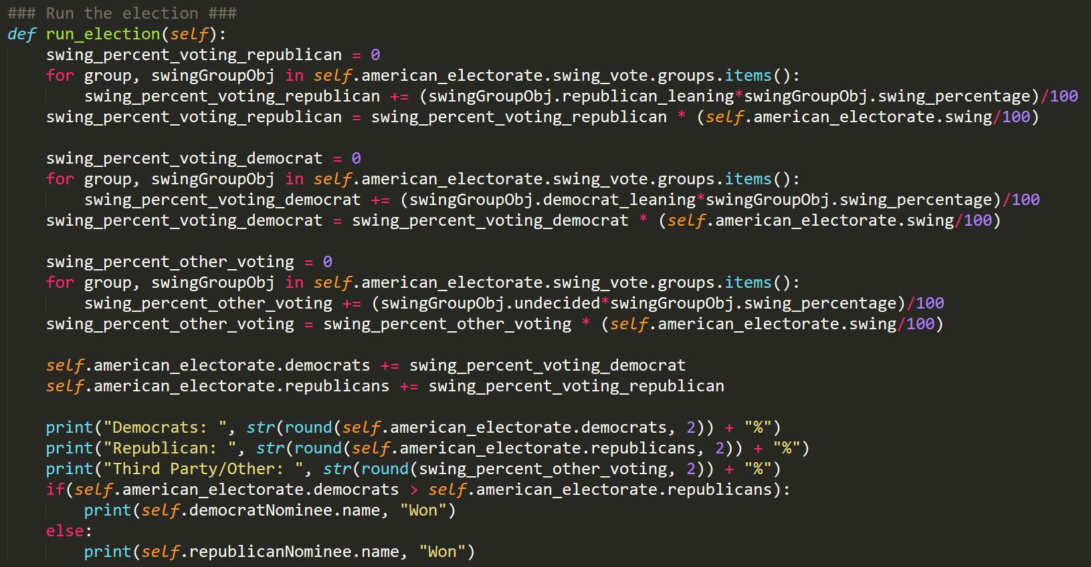
Running the Election
Notes:
Brooke

Slide 25
IV. Decisions and Drawbacks

Slide 26
Slightly-Informed but Arbitrary Decisions
How much an opinion changes
How often an event occurs
Choosing from a random group to keep importance parameter balanced
Candidate profile remains fixed in importance
Initial importance ratios for groups (initialization in general)
Notes:
Missy

Slide 27
Showcase

Slide 28

Let’s Run It!
Notes:
Ben, et. al.
Which events occurred in that year
How one event changed political opinions
How often does each candidate win

